Slide 1
BAR-CODE DETECTION AND DECODING

Slide 2
Agenda
Introduction
Methodology Overview
Step-by-Step Process
Applications
Conclusion

Slide 3
Introduction
This project’s main goal is to use computer vision and image processing techniques to identify and decode barcodes from photographs. The procedure for processing, improving, and extracting barcode information from an input image is described in this study

Slide 4
Methodology Overview
Structured image processing techniques are used in the detection and decoding process.
Even in complicated photos, steps provide resilience.
Preprocessing, augmentation, edge identification, and decoding of images are important elements.

Slide 5
Step-by-Step Process

Slide 6
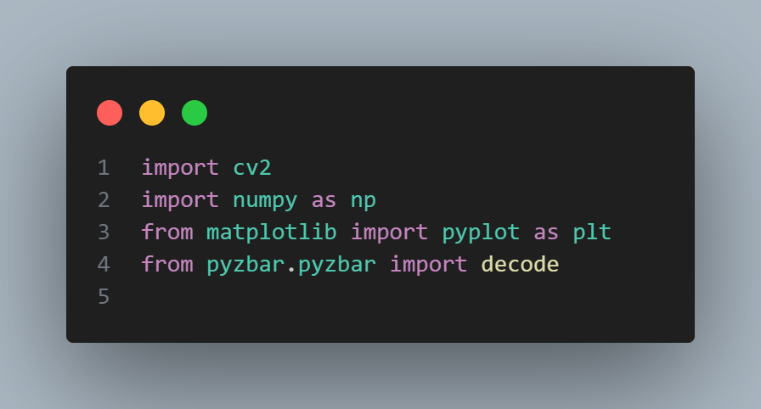
Step 1 - Importing Required Libraries
cv2 (OpenCV): Image manipulation and feature extraction.
NumPy: Numerical computing.
matplotlib.pyplot: Visualization of processing steps
pyzbar.pyzbar: Specialized library for barcode decoding.

Slide 7
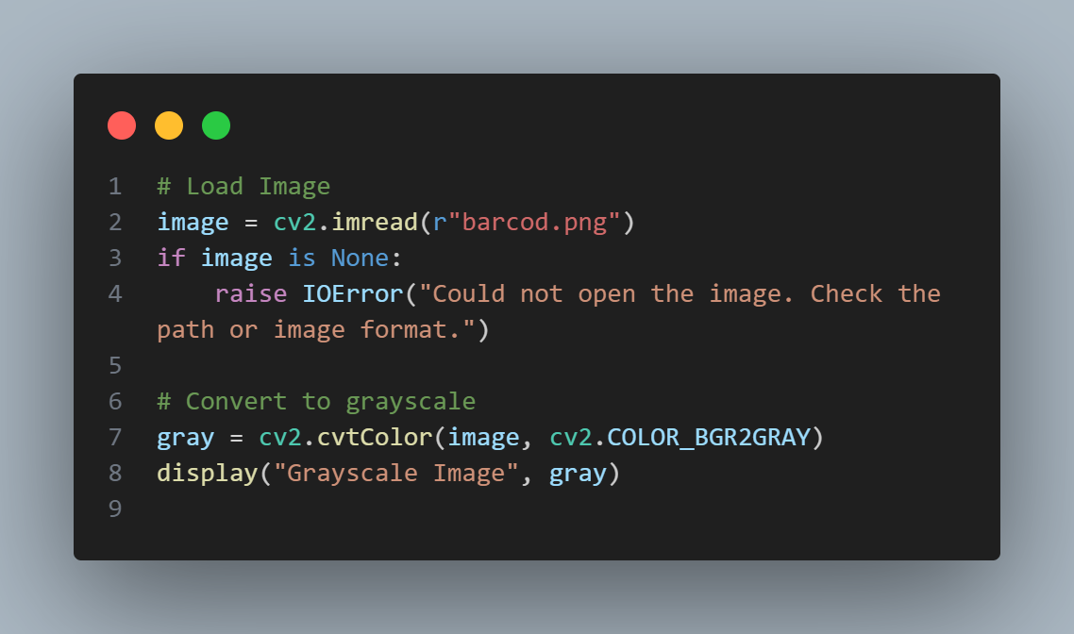
Step 2 - Preprocessing the Image
Load image using cv2.imread(). Raise error if unreadable.
Convert to grayscale using cv2.cvtColor(). Simplifies processing.

Slide 8
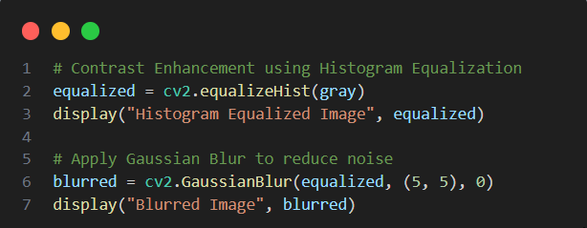
Step 3 - Enhancing Barcode Visibility
Apply Histogram Equalization (cv2.equalizeHist()) to enhance contrast.
Use Gaussian Blur (cv2.GaussianBlur()) to reduce noise while preserving barcode structures.

Slide 9
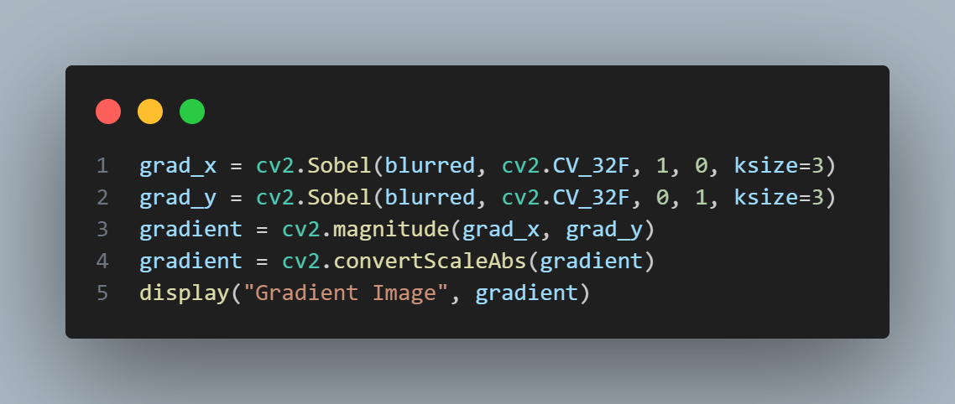
Step 4 - Edge Detection
Use Sobel Operator (cv2.Sobel()) to detect edges in X and Y directions.
Compute gradient magnitude and convert to 8-bit image.

Slide 10
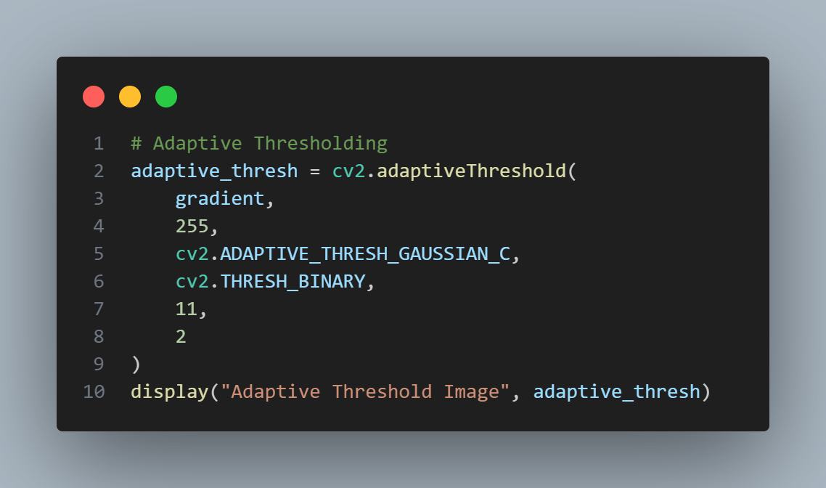
Step 5 - Binarization Using Adaptive Thresholding
Apply Adaptive Thresholding (cv2.adaptiveThreshold()) for dynamic segmentation.

Slide 11
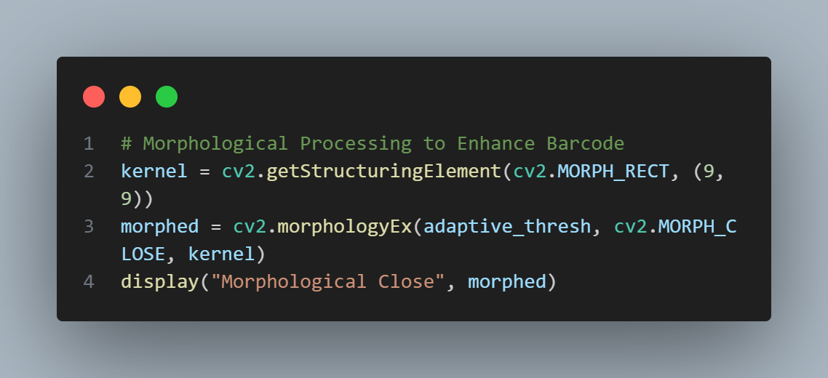
Step 6 - Morphological Transformations
Apply Morphological Closing (cv2.morphologyEx()) to enhance barcode-like structures.
Uses a rectangular kernel (cv2.getStructuringElement()).

Slide 12
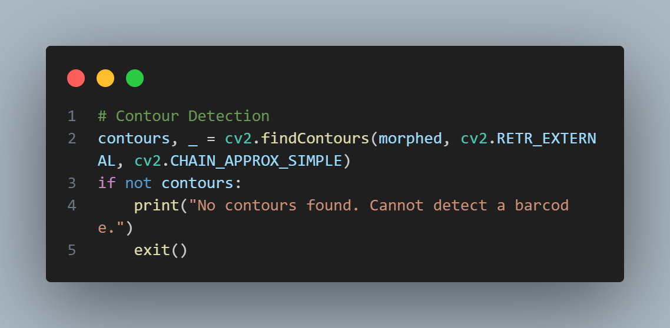
Step 7 - Contour Detection and Selection
Identify contours using cv2.findContours().
Select the largest contour assuming it represents the barcode.
Exit if no significant contour is found.

Slide 13
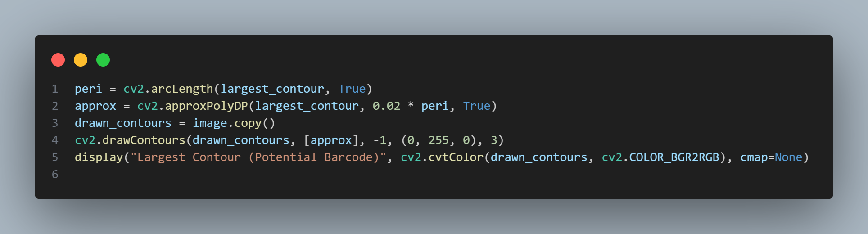
Step 8 - Contour Approximation
Calculate contour perimeter using cv2.arcLength().
Approximate contour shape with cv2.approxPolyDP().

Slide 14
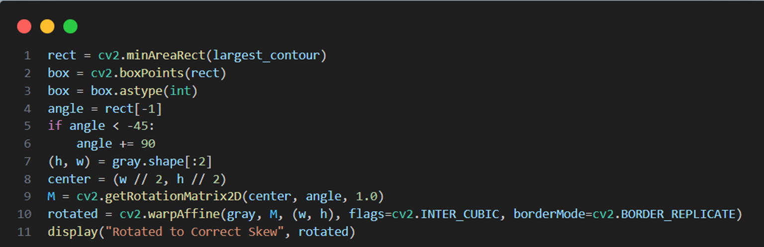
Step 9 - Skew Correction
Determine barcode orientation with cv2.minAreaRect().
Apply skew correction using cv2.getRotationMatrix2D() and cv2.warpAffine()

Slide 15
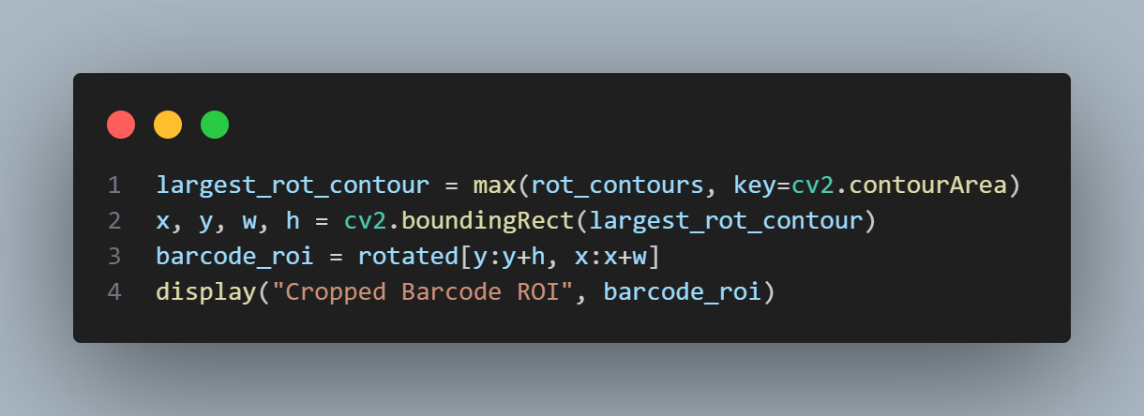
Step 10 - Extracting and Cropping the Barcode Region
Perform additional preprocessing (Gaussian blur, thresholding).
Detect contours again for precise barcode location.
Extract barcode using cv2.boundingRect() to define region of interest (ROI)

Slide 16
Step 11 - Decoding the Barcode
Pass ROI to pyzbar.decode() for barcode extraction.
Display barcode type, data, and bounding box.
Highlight detected barcode using cv2.rectangle().

Slide 17
Summary of Functionality
Image processing includes grayscale conversion, contrast enhancement, and noise reduction.
Barcode detection uses morphological operations and contour analysis.
Skew correction and cropping enhance detection accuracy.
Barcode data is successfully extracted and displayed.

Slide 18
Applications

Slide 19
Applications
Inventory Management: Automates stock tracking.
Product Tracking: Efficient barcode scanning in logistics.
Automated Data Entry: Enhances accuracy in data processing.

Slide 20
Conclusion

Slide 21
Conclusion
The presented methodology ensures reliable barcode detection and decoding.
Python-based processing makes it adaptable to various applications.
Future enhancements could include real-time barcode detection and multi-format support.

Slide 22
Thank you
aosrof@smail.ucas.edu.ps

